Slide 1
PETPOINT
API Instructions for Intake/Outcome Database
Updated
August 22, 2022

Slide 2
Send your monthly intake and outcome data to Shelter Animals Count automatically each month!
To get started use the following instructions to
Opt-In on your Shelter Animals Count Portal
AND
Map your PetPoint data to allow automation

Slide 3
STEP 1: Login to Shelter Animals Count Data Portal, https://data.shelteranimalscount.org/
STEP 2: On Profile drop-down, click Organization
STEP 3: Click Edit Organization

Slide 4
STEP 4: Near the bottom of the screen, complete the 3 fields for the API and click Update *If this section is not completed, data will not be able to be received for your organization
Identify “PetPoint” as software company
Opt-in to the API with the software company by changing to “Yes”
Enter your PetPoint Shelter ID
This is the ID used to login to your PetPoint account

Slide 5
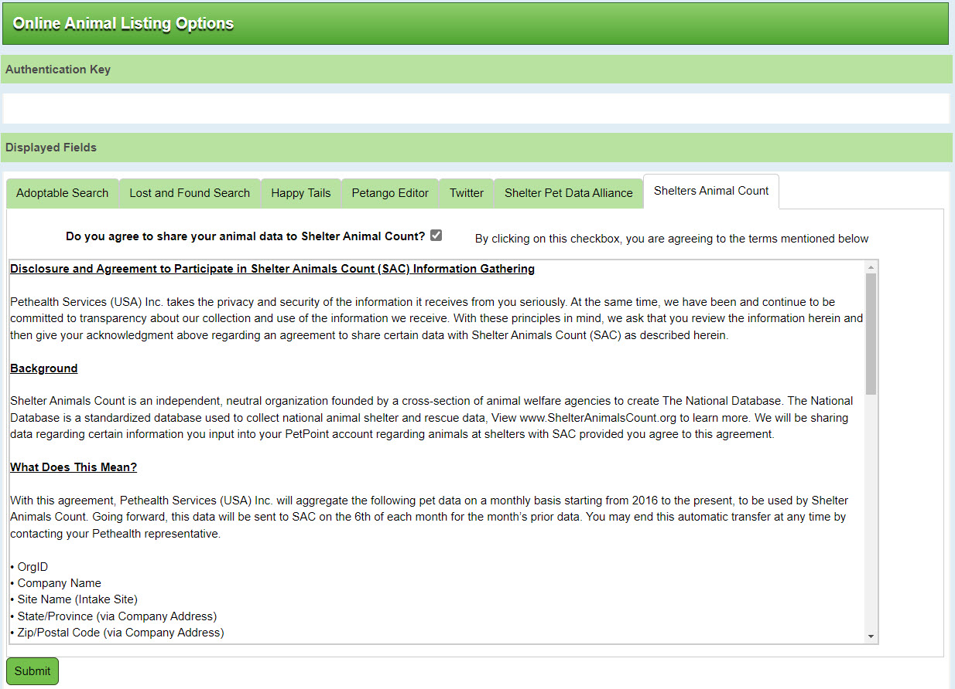
STEP 5: Log in to your PetPoint account. Under Admin Setup > Online Animal Listing Options, click the Shelter Animals Count tab and check the box agreeing to share your animal data with SAC.
Check this box to opt in

Slide 6
STEP 6: Map your intake and outcome types in PetPoint. This step is crucial--the data will not be received until this mapping is completed.
If you have already completed mapping for CSV exports, you may not need to complete this step. We do recommend that you review the mapping and ensure no updates are needed.
Begin by navigating to Administration—Add/Edit Asilomar. Click the Shelter Animals Count tab.
You are telling PetPoint where to pull the data from to calculate totals for SAC intake and outcome types.

Slide 7
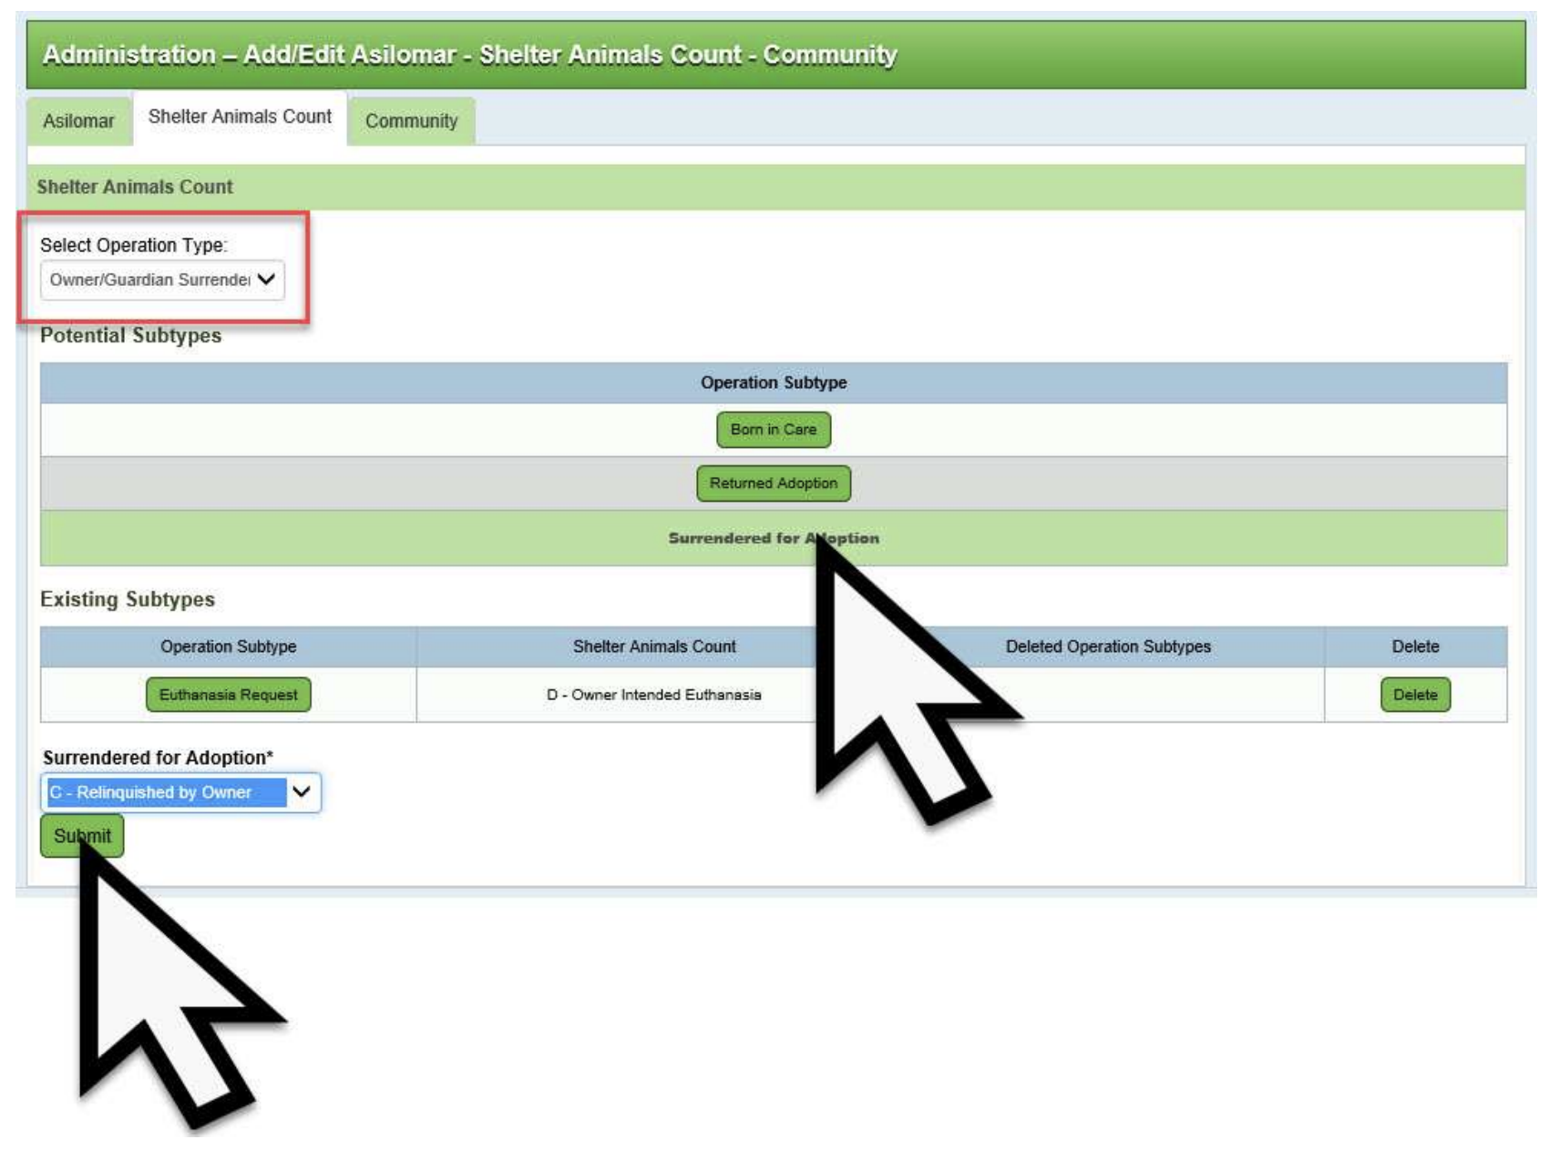
Use the “Operation Type” dropdown menu (red box) to select an Operation Type. The system will display a list of Potential Subtypes depending on your PetPoint configuration which can be mapped.
Select a Potential Subtype to map (yellow arrow). Then, near the bottom of the page, click the drop-down menu underneath the name of the Potential Subtype you selected. Choose the appropriate Intake or Outcome Type that best fits that subtype.
Click Submit (white arrow).
You are telling PetPoint to count all intakes or outcomes with that subtype as the SAC intake/outcome type you have chosen. In this example, we are telling PP to count the subtype “Surrendered for Adoption” under the SAC Intake Type “Relinquished by Owner”.

Slide 8
Each Potential Subtype that you assign will then appear in the Existing Subtypes block with the selected mapping.
Repeat these steps until all the Potential Subtypes for each Operation Type have been mapped to a corresponding SAC intake or outcome type.
If your organization only serves cats and dogs, you’re done! Skip the next two pages.
If your organization serves additional species, please complete the steps on the pages 9 and 10.
Additional details about the mapping process cam be found here: https://pethealth.force.com/community/s/article/How-to-setup-the-Shelter-Animals-Count-reports

Slide 9
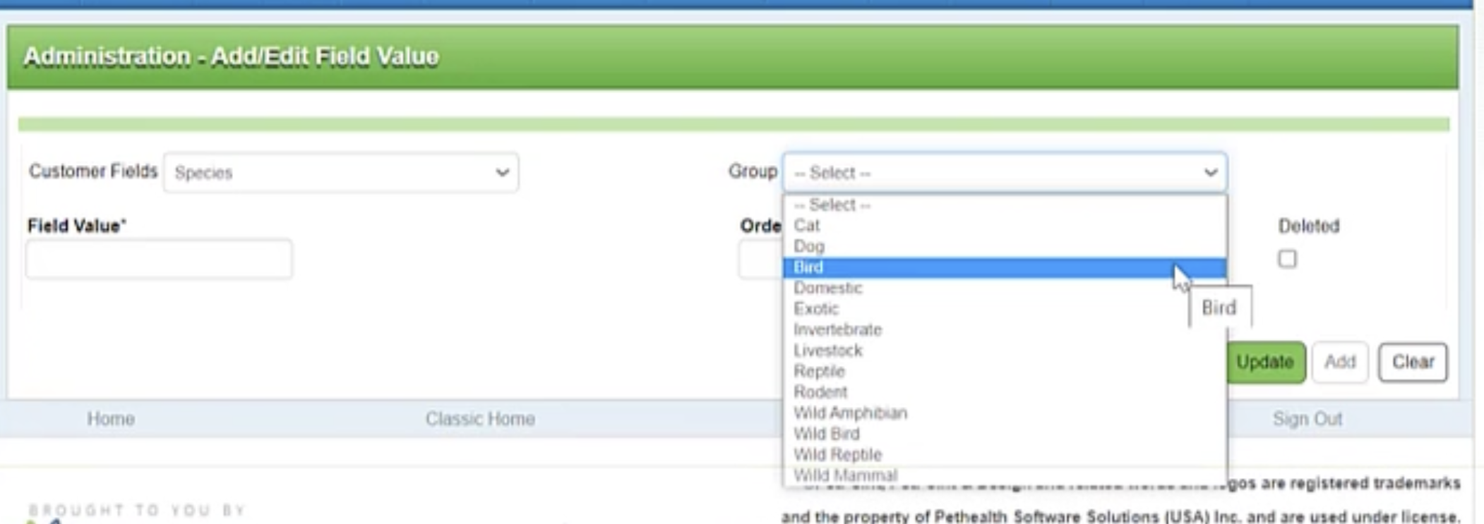
Navigate to Admin → Admin Options. Under Setup, select “Add/Edit Field Value”.
Select “Species” from the Customer Fields drop-down, then select the species group you’d like to map from the Group dropdown.

Slide 10
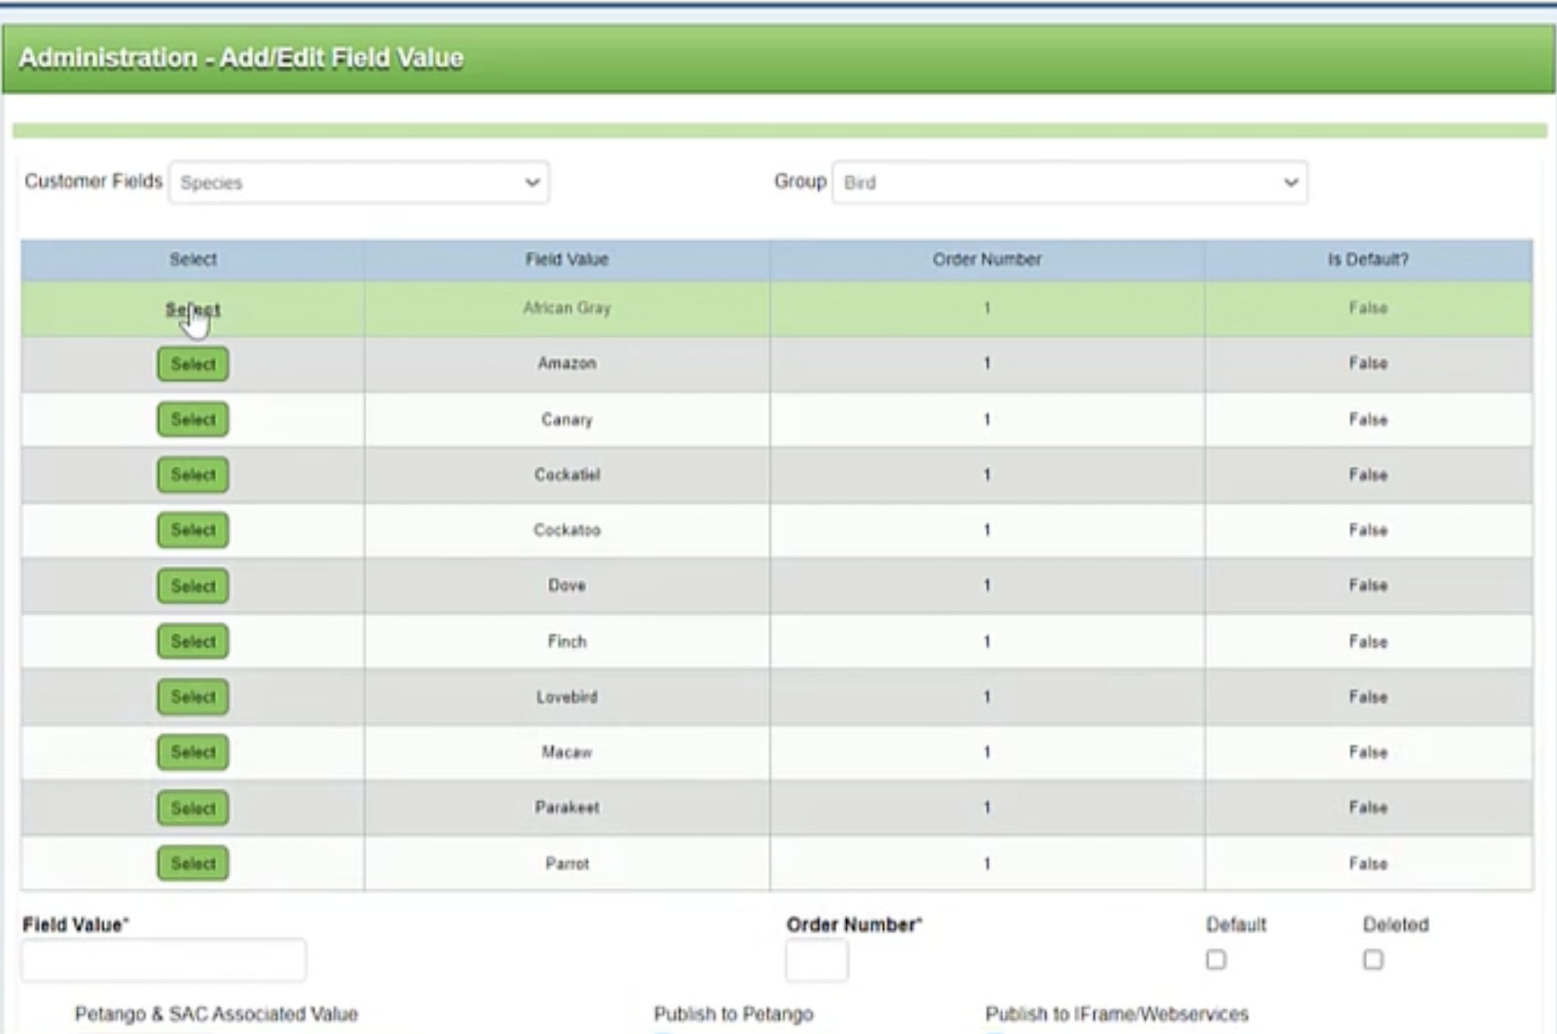
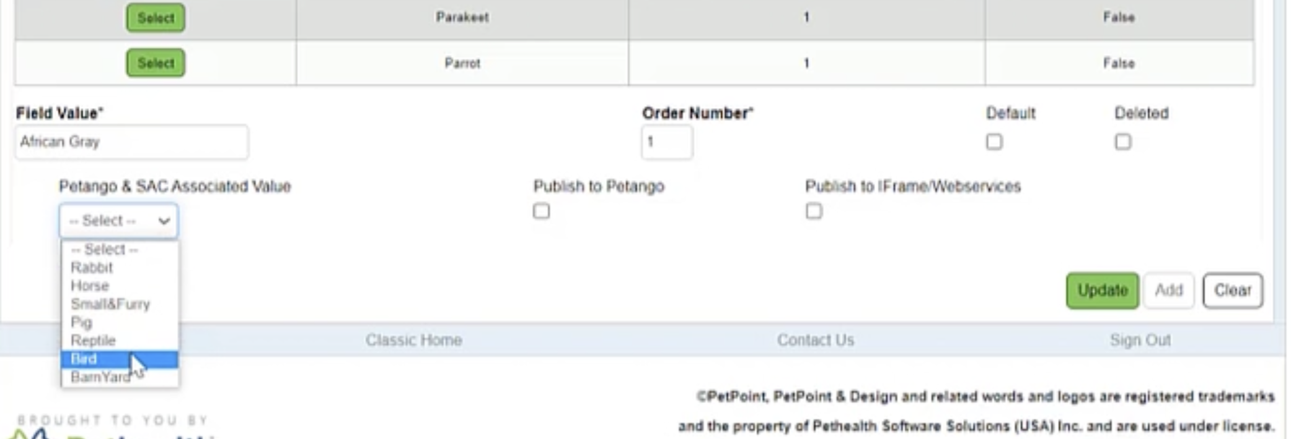
Choose a species from the list by clicking Select.
At the bottom left corner of the page, click the dropdown “Petango & SAC Associated Value” and select the species group you would like this species assigned to in SAC. Click Update. Repeat for the next species.
Repeat these steps for each species. Then, choose the next species group to map (“Group” at top of page). Make sure to map all species groups your organization serves.
You are telling the software that when an animal with this species appears in the data, it should be assigned to the corresponding species group in SAC. In this example, we are telling the software that the species ”African Gray” in the PP species group “Bird” should be counted as a “Bird” in SAC.

Slide 11
STEP 7: No longer manually upload or enter your data again!
NOTES REGARDING API:
You MUST complete the instructions for updating your SAC organization profile, check the opt-in box in your PetPoint account, AND have completed the mapping step for the API to correctly send data.
Monthly data will be automatically uploaded to your data portal on the 6th of each month for the prior month (i.e. on August 6, July data will be uploaded).
We recommend you confirm that the data came through correctly during the first month the API is active by viewing the data in your SAC portal.
You will still have access to upload a CSV or manually change data if you need to.
You can opt-out of the API at any time by notifying your PetPoint representative

Slide 12
INFO@SHELTERANIMALSCOUNT.ORG

