Slide 1
PETSTABLISHED
API Instructions for Intake/Outcome Database
Updated
December 5, 2023

Slide 2
Send your monthly intake and outcome data to Shelter Animals Count automatically each month!
To get started use the following instructions to
Opt-In on your Shelter Animals Count Portal
AND
Turn the API on in your Petstablished account

Slide 3
STEP 1: Login to Shelter Animals Count Data Portal, https://data.shelteranimalscount.org/
STEP 2: On Profile drop-down, click Organization
STEP 3: Click Edit Organization

Slide 4
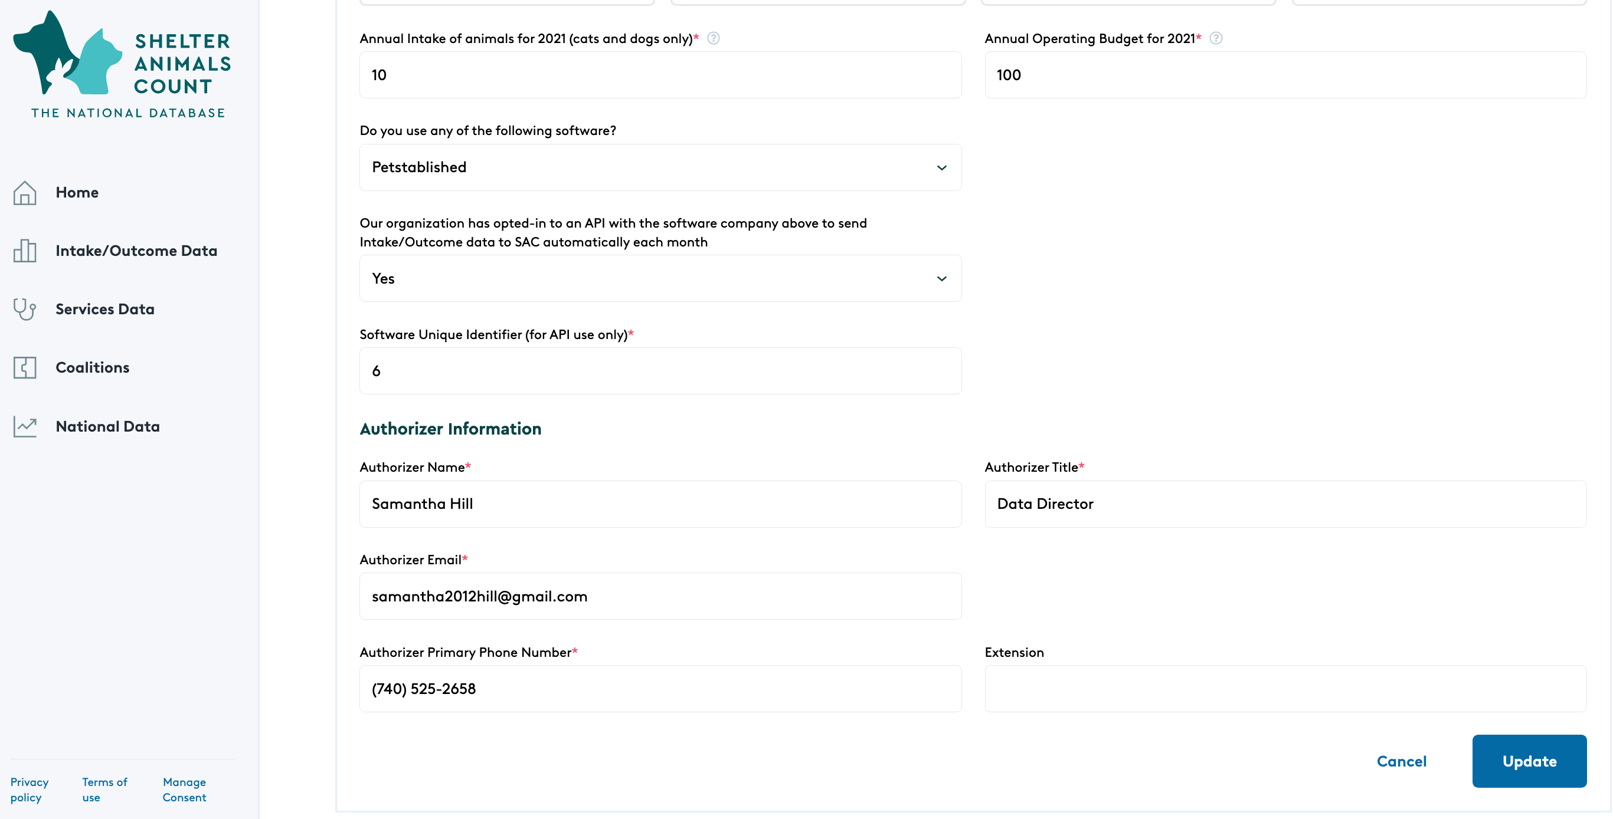
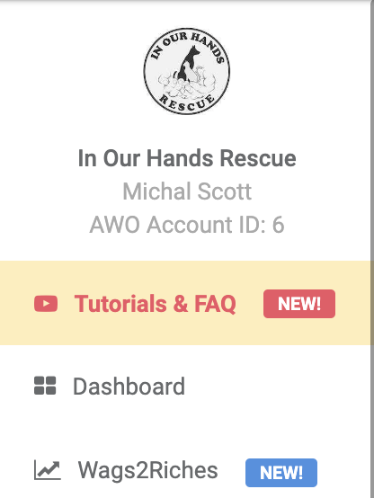
STEP 4: Verify that the organization EIN is entered and correct. STEP 5: Near the bottom of the screen, complete the 3 fields for the API and click Update *If this section is not completed, data will not be able to be received for your organization
Identify “Petstablished” as software company
Opt-in to the API with the software company by changing to “Yes”
Enter your Petstablished AWO Account ID
This account # is found under your organization info on the left side of your Petstablished dashboard

Slide 5
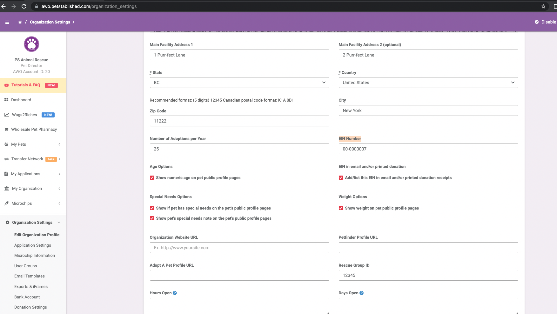
STEP 6: Login to Petstablished Account STEP 7: On the left side of the screen, click Organization Settings > Edit Organization Profile. STEP 8: Verify that the organization EIN is entered and correct. For Canadian organizations please enter your organization’s Business Number
Enter your organization’s EIN here, If Canadian org enter your organization’s BN

Slide 6
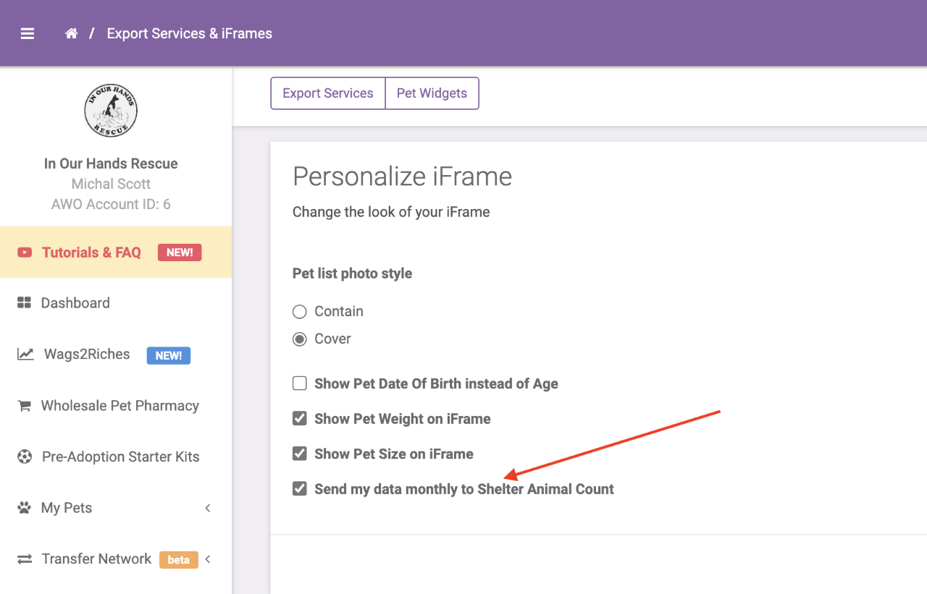
STEP 9: Check the “Send my data monthly to Shelter Animals Count” box under the Export Services & iFrames menu
Check this box

Slide 7
STEP 9: No longer manually upload or enter your data again!
NOTES REGARDING API:
You MUST complete the instructions for updating your SAC organization profile AND turn on the API in your Petstablished account for the API to correctly send data.
Your organization’s EIN entry must match in both the SAC and Petstablished profiles for the API to correctly send data.
Monthly data will be automatically uploaded to your data portal by the 6th of each month for the prior month (i.e. by August 6, July data will be uploaded).
We recommend you confirm that the data came through correctly during the first month the API is active by viewing the data in your SAC portal.
Any updates to your data will be automatically uploaded to the data portal throughout the month. You can also reach out to your Petstablished representative to send data for a particular month/species at any time.
You will still have access to upload a CSV or manually change data if you need to.
You can opt-out of the API at any time by turning off the API in your Petstablished Account

Slide 8
INFO@SHELTERANIMALSCOUNT.ORG

